Slide 1
CIS 4930-001: Introduction to Augmented and Virtual Reality
Introduction to Augmented Reality

Slide 2
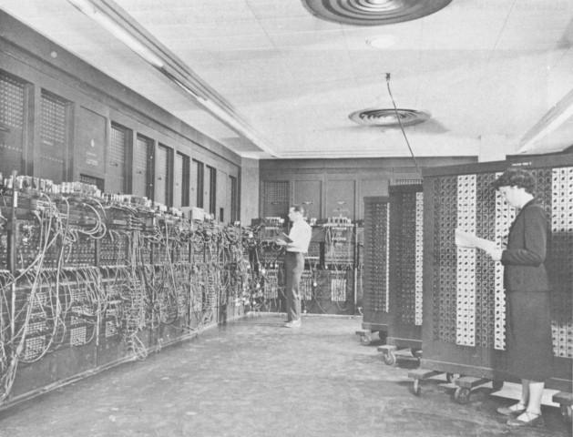
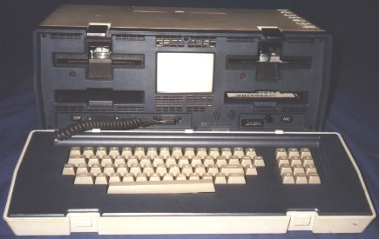
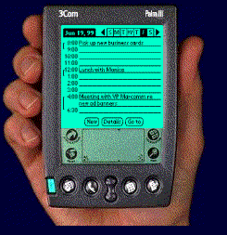
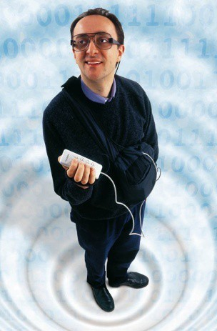
Trend Towards Invisible Interfaces
Trend from room scale to invisible computing
Making Computers Invisible
hide the computer in the real world
Ubiquitous Computing
put the user inside the computer
Virtual Reality

Slide 3
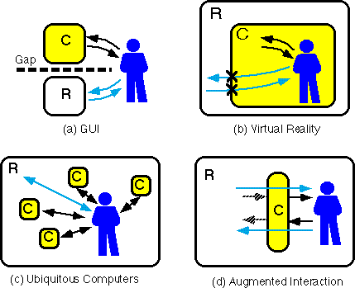
Making Interfaces Invisible
Rekimoto, J. and Nagao, K. 1995. The world through the computer: computer augmented interaction with real world environments. In Proceedings of the 8th Annual ACM Symposium on User interface and Software Technology. UIST '95. ACM, New York, NY, 29-36.

Slide 4
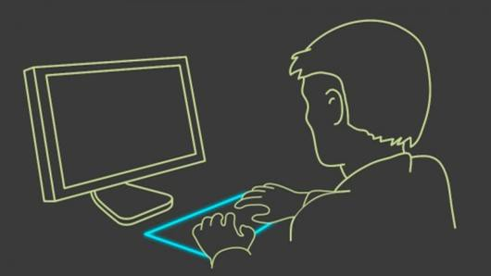
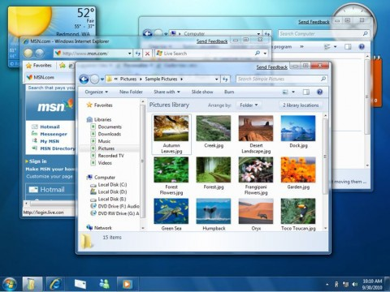
Graphical User Interfaces
Separation between real and digital worlds
WIMP (Windows, Icons, Menus, Pointer) metaphor

Slide 5
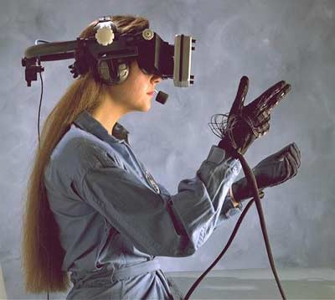
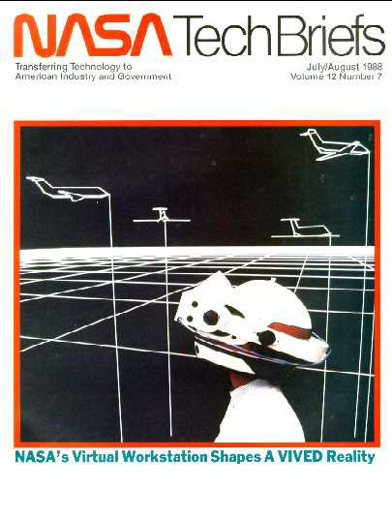
Virtual Reality
Circa 1985

Slide 6
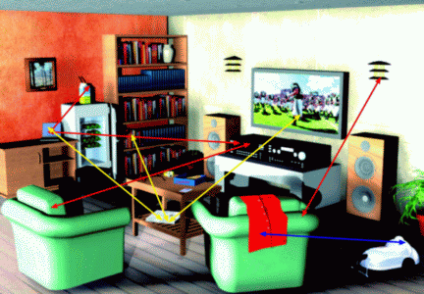
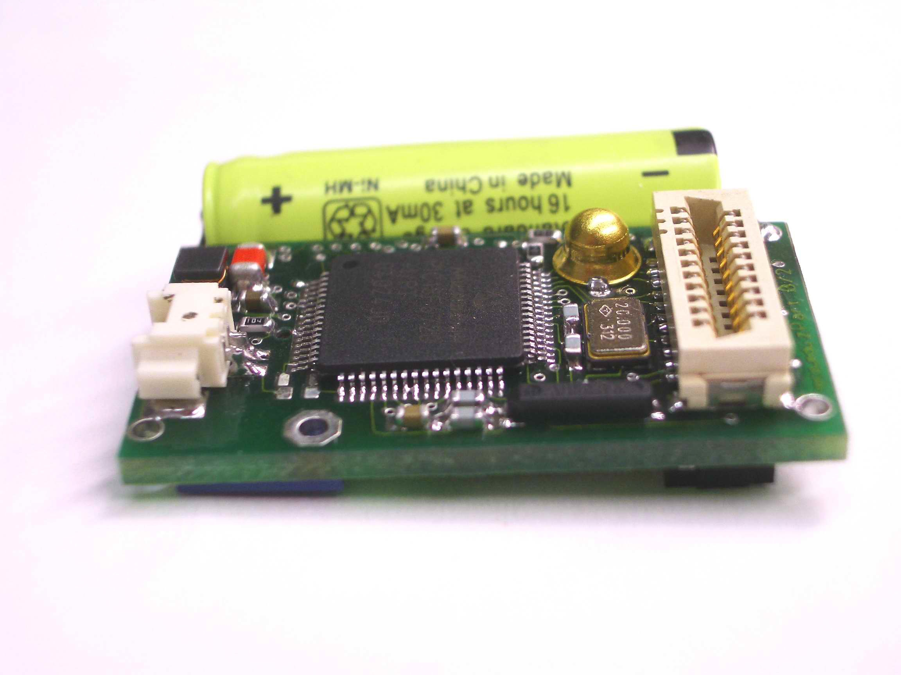
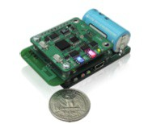
Ubiquitous Computing
Computing and sensing embedded in real world
Particle devices, RFID, motes, arduino, etc

Slide 7
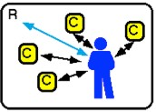
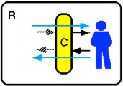
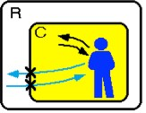
From Reality to Virtual Reality
Ubiquitous Computing
Augmented Reality
Virtual Reality

Slide 8
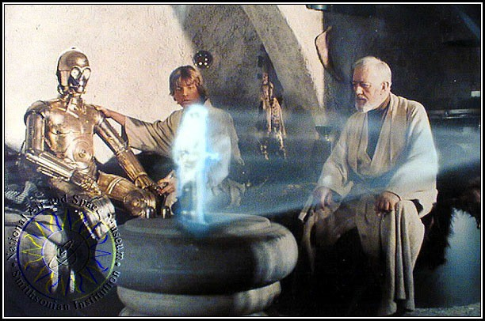
Augmented Reality
1977 – Star Wars

Slide 9
Augmented Reality
Defining Characteristics [Azuma 97]
Combines Real and Virtual Images
Both can be seen at the same time
Interactive in real-time
The virtual content can be interacted with
Registered in 3D
Virtual objects appear fixed in space
Azuma, R. T. (1997). A survey of augmented reality. Presence, 6(4), 355-385.

Slide 10
Augmented Reality vs. Virtual Reality
Augmented Reality
System augments the real world scene
User maintains a sense of presence in real world
Needs a mechanism to combine virtual/real worlds
Hard to register real and virtual
Virtual Reality
Totally immersive environment
Senses are under control of system
Need a mechanism to feed virtual world to user
Hard to make VR world interesting
Notes:
Computer generated virtual objects must be accurately registers with the real
in all dimensions.
Errors in registration prevent the real and virtual images from being seen as fused.
Registration must be maintained while the user moves around in the virtual
environment.
Changes in registration can be distracting or physically disturbing.

Slide 11
Mixed reality
A system that combines real and virtual objects and information.

Slide 12

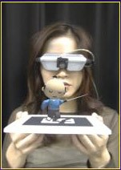
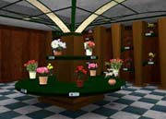
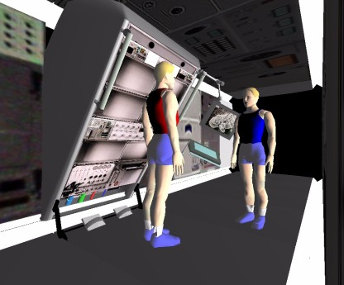
Milgram’s Reality-Virtuality Continuum
Milgram coined the term “Augmented Virtuality” to identify systems which are mostly synthetic with some real world imagery added such as texture mapping video onto virtual objects.
Mixed Reality (MR)
Real Environment
Augmented Reality (AR)
Augmented Virtuality (AV)
Virtual Environment
P. Milgram and A. F. Kishino, Taxonomy of Mixed Reality Visual Displays. IEICE Transactions on Information and Systems, E77-D(12), pp. 1321-1329, 1994.
Notes:
Augmented reality is closest to the real world because mainly a user is perceiving
the real world with just a little computer generated data.
This distinction will probably fade as technology improves.

Slide 13
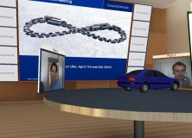
Augmented Virtuality
VR with windows into the real world

Slide 14
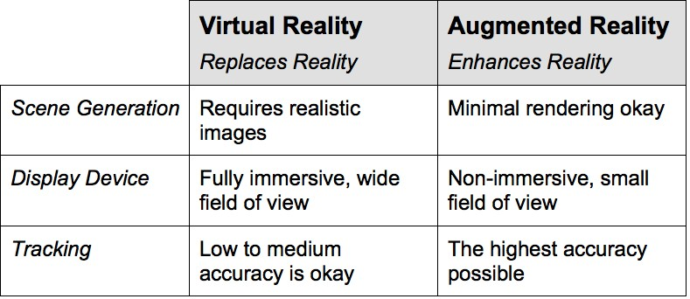
AR vs VR

Slide 15

Other Context: The Metaverse
Neal Stephenson’s “SnowCrash”
The Metaverse is the convergence of:
virtually enhanced physical reality
physically persistent virtual space
Metaverse Roadmap
http://metaverseroadmap.org/

Slide 16
Metaverse Dimensions
Augmentation technologies that layer information onto our perception of the physical environment
Simulation refers to technologies that model reality
Intimate technologies are focused inwardly, on the identity and actions of the individual or object
External technologies are focused outwardly, towards the world at large

Slide 17
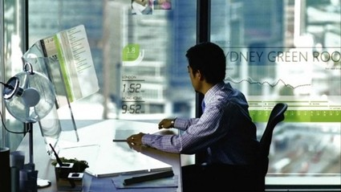
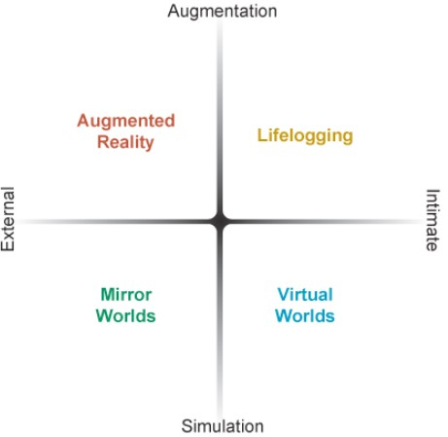
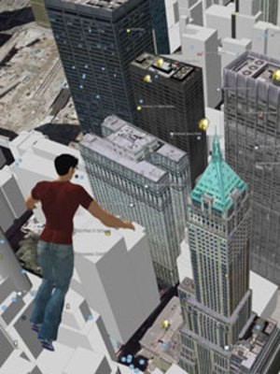
Four Key Metaverse Components

Slide 18
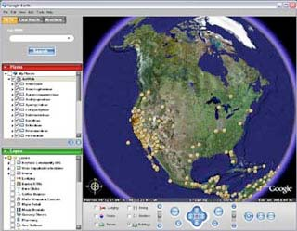
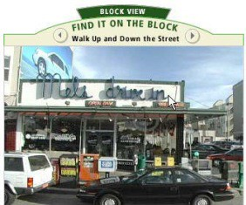
Mirror Worlds
Mirror worlds are informationally-enhanced virtual models of the physical world.
Google Earth, Street View, etc
ogle Maps

Slide 19
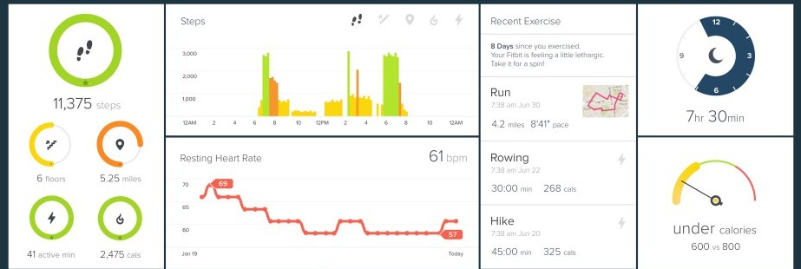
LifeLogging
Technologies record and report the intimate states and life histories of objects and users
Nokia LifeBlog, Nike+, FitBit

Slide 20
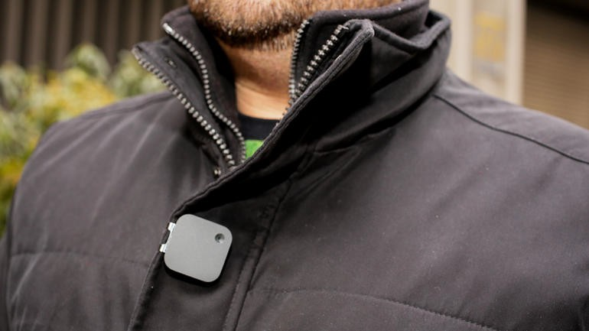
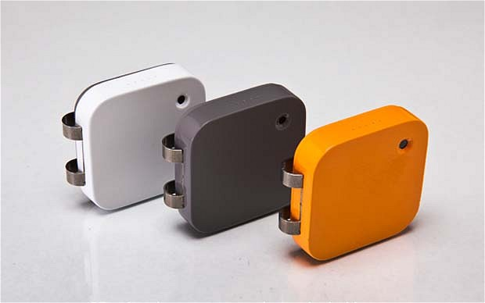
Narrative Clip
Wearable camera
Automatic picture capture - 2 pics/minute
http://getnarrative.com

Slide 21
AR Application Areas
Computer games
Map-assisted navigation
Urban planning / Design / construction
Tourism / Cultural heritage
Maintenance
Training
Battlefield information display
Robot-assisted surgery
Virtual tours—real estate, medical facilities, etc.

Slide 22
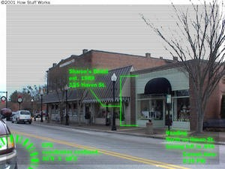
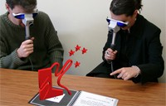
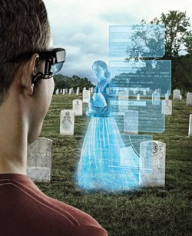
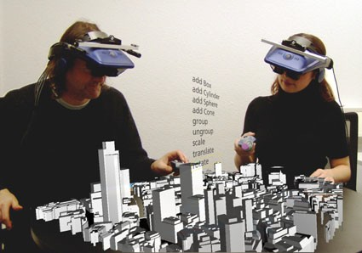
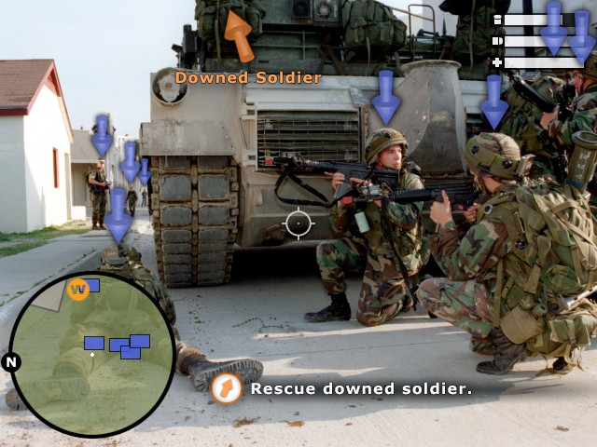
Augmented Reality Examples

Slide 23
AR in teleconferencing
Person works at real desk
Remote collaborator represented by picture or video or “talking head”
Objects of discussion; e.g. a patient’s brain image, might also be fused into visual field
From University of Washington HIT Lab

Slide 24
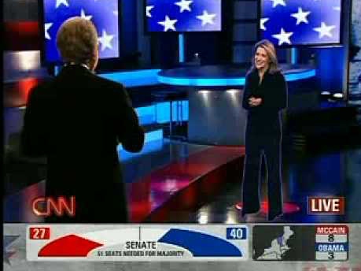
CNN Virtual View (2008)
https://youtu.be/v7fQ_EsMJMs

Slide 25
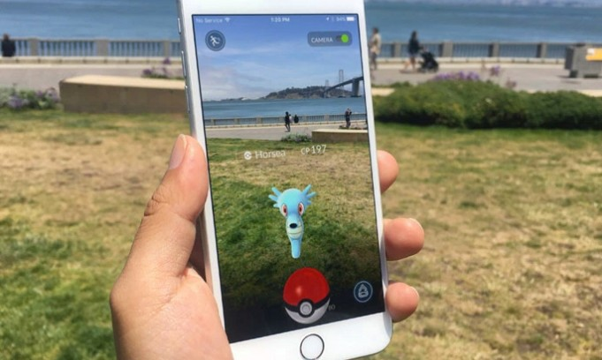
Pokemon GO

Slide 26
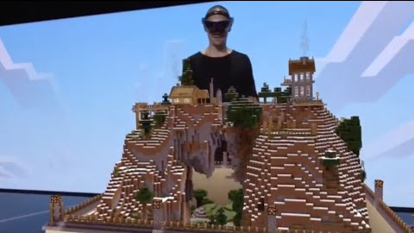
Microsoft Hololense
https://youtu.be/xgakdcEzVwg

Slide 27

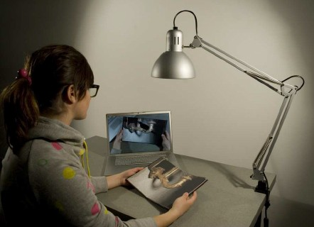
Example: Haunted Book/AR Book
Camera hidden in lamp object
AR content seamlessly integrated into real book
Natural page turning/manipulation interaction
Scherrer, C., Pilet, J., Fua, P., & Lepetit, V. (2008, September). The haunted book. In Proceedings of the 7th IEEE/ACM international Symposium on Mixed and Augmented Reality (pp. 163-164). IEEE Computer Society.

Slide 28
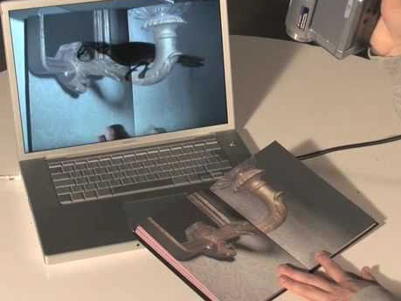
AR Book Demo
https://youtu.be/XbsfamN78Tc

Slide 29
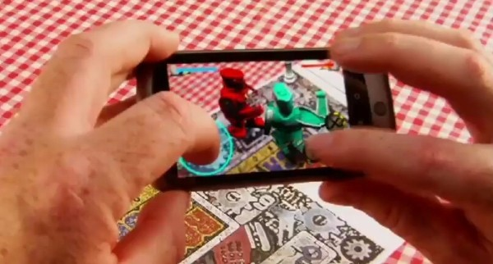
Gaming: Rock-em Sock-em
Shared AR Demo
Markerless tracking

Slide 30

Rockem Sockem Demo
https://youtu.be/hXtq1qBMLIw

Slide 31
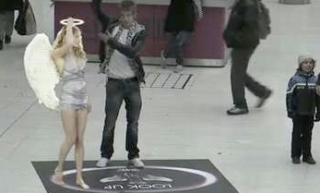
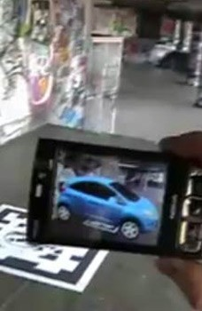
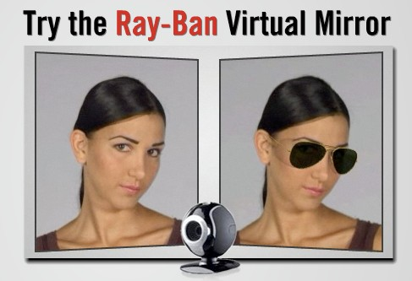
Sales and Marketing
Connect with brands and branded objects
Location Based Experiences
Lynx Angels
Web based
Rayban glasses
Mobile
Ford Ka campaign
Print based
Red Bull Magazine

Slide 32
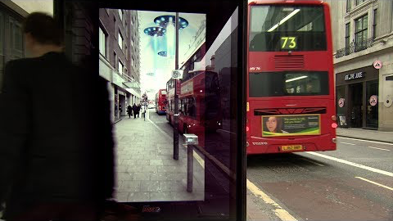
Pepsi AR Experience (2014)
https://youtu.be/Go9rf9GmYpM

Slide 33
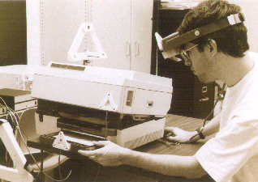
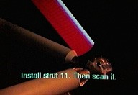
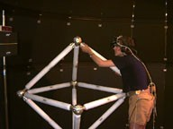
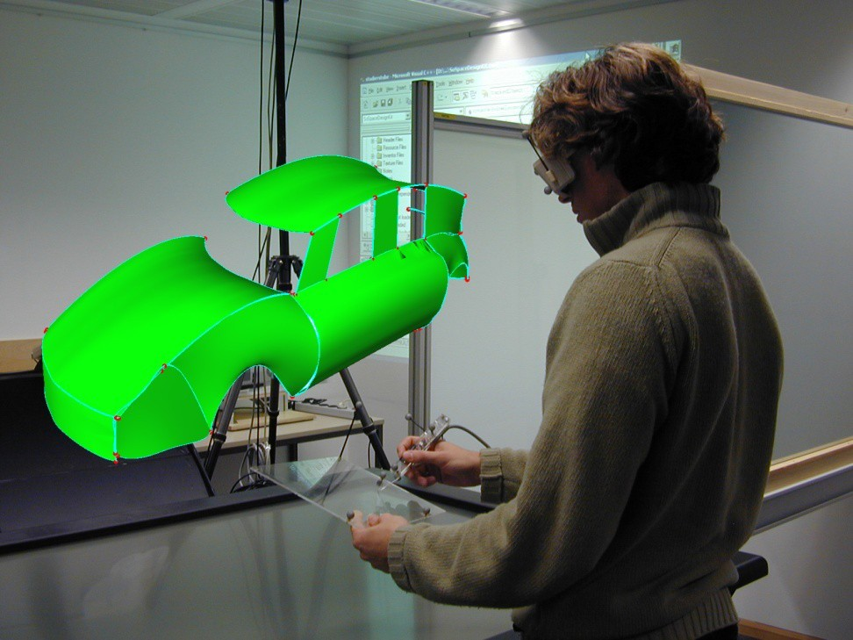
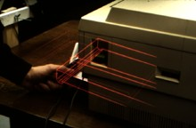
Assembly and Maintenance
© 1996 S. Feiner, B. MacIntyre, &
A. Webster, Columbia University
© 1993 S. Feiner, B. MacIntyre, &
D. Seligmann, Columbia University

Slide 34
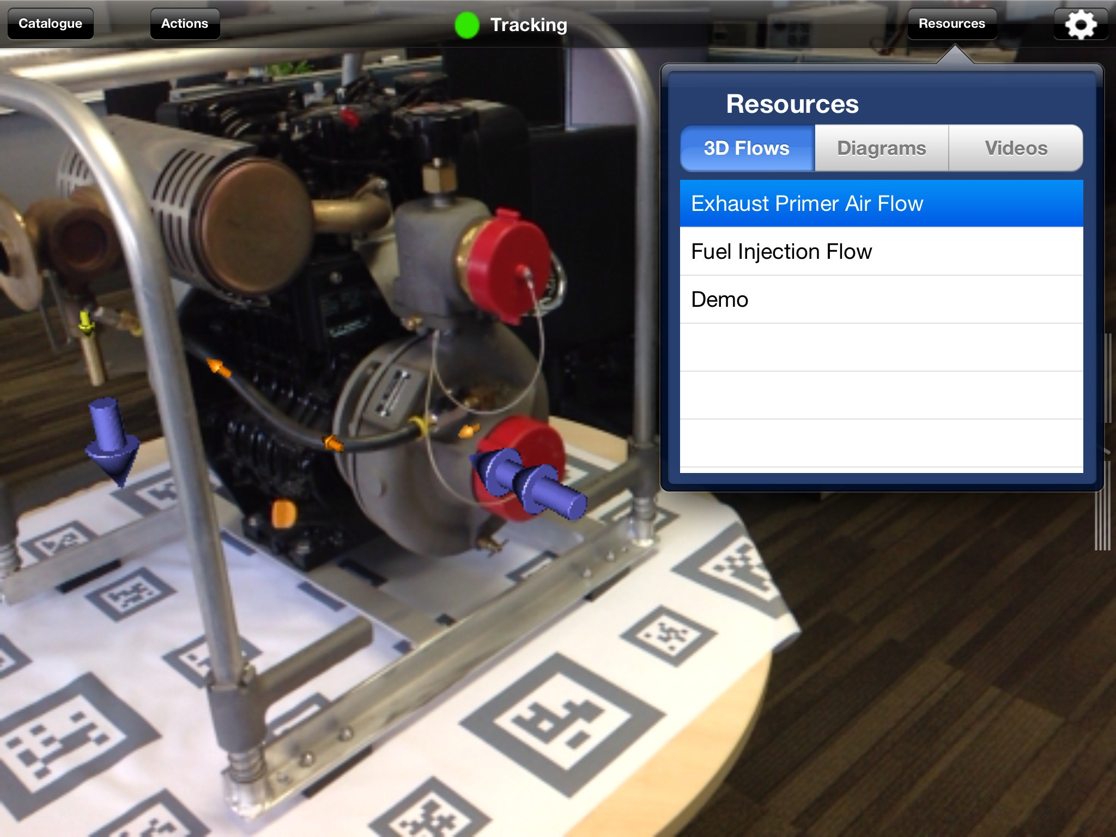

Maintenance Systems
Ngrain
http://www.ngrain.com/
Training authoring tool
Model based AR tracking
ScopeAR
http://www.scopear.com/
Remote assistance
Image based tracking

Slide 35

Ngrain Example
https://youtu.be/xthEaobGzs4

Slide 36



Medical AR Trials
Sauer et al. 2000 at Siemens Corporate Research, NJ
Stereo video see through
F. Sauer, Ali Khamene, S. Vogt: An Augmented Reality Navigation System with a Single-Camera Tracker: System Design and Needle Biopsy Phantom Trial, MICCAI 2002

Slide 37

Medical Demo
https://youtu.be/kFQulgeYh7w

Slide 38


Interactive Museum Experiences
BlackMagic
Virtual America’s Cup
410,000 people in six months
MagicPlanet
TeManawa science museum
Virtual Astronomy
Collaborative AR experience
AR Volcano
Interactive AR kiosk
Scienceworks museum, Melbourne

Slide 39


Digital Binocular Station
http://www.DigitalBinocularStation.com/

Slide 40

Digital Binocular Station
https://youtu.be/mqLAKBX0om4

Slide 41

CityViewAR Application
https://youtu.be/fdgrXxJx4SE

Slide 42

Collaboration Example: Holoportation
Augmented Reality + 3D capture + high bandwidth
http://research.microsoft.com/en-us/projects/holoportation/

Slide 43

HoloPortation Video
https://youtu.be/7d59O6cfaM0

Slide 44

Human operating with AR
Think of a heads up display on your auto windshield, or on the instrument panel. What could be there to help you navigate?
(Vectors to nearby eating places? Blinking objects we might collide with? Congestion of nearby intersections? Web pages?)

Slide 45

Special devices needed to fuse/register real and generated images
Computer Graphics Problem – Human sees graphics generated from 3D/2D models
Tracking/Pose Problem – Graphics system needs to know how the human is viewing the 3D environment
Optics Problem – Human sees both real and virtual environments
From University of Washington HIT Lab

Slide 46
Difficult augmentation problem
Human very sensitive to misregistration
Some applications OK – e.g. circuit board inspection
Tough calibration procedures for average user

Slide 47
Combining the Real and Virtual Worlds
We need:
Precise models
Locations and optical properties of the viewer (or camera) and the display
Calibration of all devices
To combine all local coordinate systems centered on the devices and the objects in the scene in a global coordinate system
Notes:
Need these things to seamlessly combine the real and virtual worlds.
Need precise models of the user’s environment and how it is sensed.

Slide 48


Combining the Real and Virtual Worlds (cont)
Register models of all 3D objects of interest with their counterparts in the scene
Track the objects over time when the user moves and interacts with the scene
Notes:
1st picture - real world
2nd picture - real world with virtual objects and inter-reflections and virtual
shading

Slide 49
Realistic Merging Requires
Objects to behave in physically plausible manner
Occlusion
Collision detection
Shadows

Slide 50


Strong vs. Weak AR
Weak AR
Imprecise tracking
No knowledge of environment
Limited interactivity
Handheld AR
Strong AR
Very accurate tracking
Seamless integration into real world
Natural interaction
Head mounted AR

Slide 51

AR Tracking Examples
Optical / vision-based tracking
Ensures portability
Large number of tracked objects
Registration and low latency are crucial for AR systems
Sourceless inertial orientation tracking
GPS (or other) position tracking
Generally requires high accuracy
GPS enables mobile (global) outdoor AR
https://youtu.be/TqGAqAFlGg0

Slide 52

“Mobile” outdoor AR
1997 “Touring Machine” Backpack systems (Feiner)
User wears/carries:
Computer
HMD
Inertial tracker
GPS unit/antenna
Input device(s)

Slide 53
Performance Issues with Tracking
Accuracy of the registration of the real and virtual image
Noise – position and pose of camera with respect to the real scene
Image distortions
Time delays
Update rate for generating the augmenting image
Can limit registration accuracy – “1 ms = 1mm error”

Slide 54


AR Display Technologies
Monitor Based
Laptops
Cell phones
Projectors (more Ubiquitous Computing)
Head Mounted Displays
Video see-through
Optical see-through

Slide 55
Monitor Based Augmented Reality
Simplest available
Treat laptop/cell phone as a window through which you can see AR world.
Sunglasses demo
Notes:
Sometimes referred to as “Windows on the World” or “Fish Tank VR”
Other display technologies are used to increase the sense of presence.

Slide 56

Monitor Based AR – Successful commercialization
Yellow line in football broadcasts
Glowing hockey puck
Replace times square billboards with own ads during broadcast
Baseball cards
Ad campaigns

Slide 57

Optical see-through HMD
Notes:
Works by placing optical combiners in front of the user’s eyes.
Combiners are partially transmissive - so user can look directly through them
and see the real world.
Combiners are partially reflective - so user can also see virtual images bounced
off the combiners from head-mounted monitors.
Similar to Head-Up Displays (HUDs) commonly used in military aircraft.
Can see through the display even if the power is turned off.

Slide 58


Video see-through HMD
Notes:
Works by combining a closed-view HMD with one or two head-mounted video
cameras
Video cameras provide the user’s view of the real world.
Video from cameras is combined with graphics images by the scene generator to
blend the two worlds.
Result is sent to the monitors in from on the user’s eyes in the closed-view HMD.
User has no direct view of the real world.
If power is off, the user is “blind.”

Slide 59
Advantages of…
Monitor Displays
Consumer-level equipment
Most practical
Optical see-through HMD
Simplicity
Resolution
No eye offset
Video see-through HMD
Flexibility in composition strategies
Real and virtual view delays can be matched
Notes:
Flexibility in composition strategies
Basic Problem with optical is the virtual objects do not completely obscure real- world objects because
combiners allow light from both the virtual and real sources.
Virtual objects appear ghost-like and semi-transparent, damaging the illusion of reality because
occlusion is a strong depth cue.
Video see-through is much more flexible about how it merges real and virtual - they are both in
digitized form so compositors can do a pixel-by-pixel comparison.
Produces more compelling environments.
Wide Field of View
Distortions in optical systems are a function of the radial distance away from the optical axis - the
further you look away from the center of the view, the more distorted it gets.
A digitized image taken through a distorted optical system can be undistorted by applying image
processing techniques to unwarp the image.
This requires significant amounts of computation - but this constraint will lessen as computers
become faster.
It is harder to build wide FOV displays with optical see-through constraints.
Distortions of the user’s view of the real world could be corrected optically, but complex optics are
expensive and make the HMD heavier.
Real and Virtual delays can be matched
Delay the video of the real world to match the delay in the virtual image stream. (can’t be done in
optical because it gives the user a direct view of the real world.)
Disadvantage: eliminating dynamic error comes at the cost of delaying both the real and virtual
scenes - user sees everything lagging behind.

Slide 60
Technical Challenges in AR/MR
Occlusion and depth perception
Text display and legibility
Visual differences between real and virtual objects
Registration and tracking
Bulky HMDs and other equipment

